Slide 1

Choose Ohio First Scholarship Program (COFSP)
Professional Development
Debbie Liberi and Marie Pollitt
Professional Development Session 1:
COFSP, RET and CEEMS Components
and Challenge Based Learning
Swift 616
University of Cincinnati
Monday, September 21, 2015
4:30 – 6:30 pm

Slide 2
Acknowledgements
Research Experiences for Teachers (RET) Funded by NSF’s RET Program: Grant # EEC-1404766.
Ohio Board of Regents: OBR COF 08-23 Grant

Slide 3
WHO are the KEY players?
COFSP Fellows – 6 senior engineering students, recipients of Choose Ohio First Scholarship Program
RET Teachers – 12 classroom teachers who participated in the Research Experiences for Teachers grant this past summer.
CEEMS Teachers – 2 classroom teachers from Cincinnati Enhanced Engineering, Math and Science Program, Cohort 3, who are involved in creating 5- 6 units on CBL and EDP.
CEEMS Fellows – 4 Engineering PhD Candidates who are CEEMS Fellows grant recipients.

Slide 4
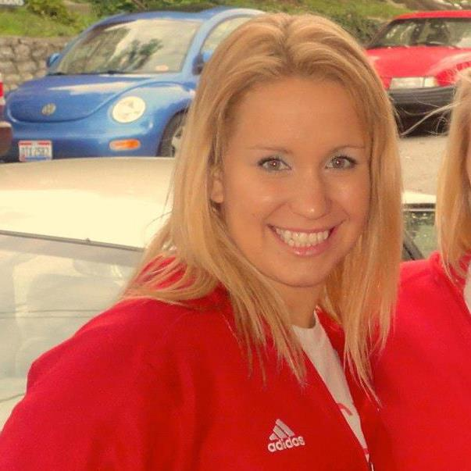
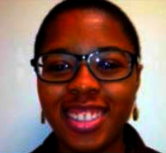
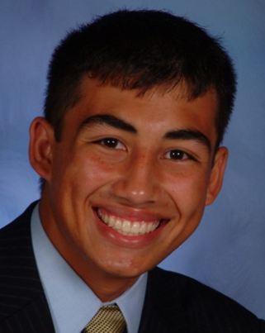
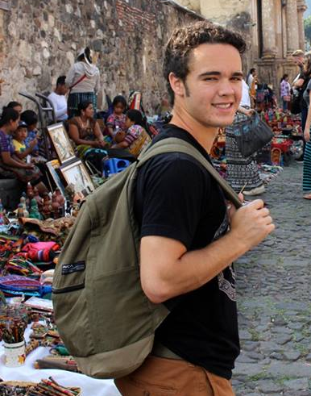
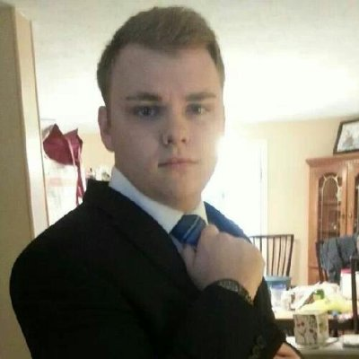
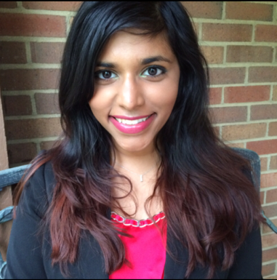
Introductions: COFSP Fellows
6 COFSP Fellows: Please stand.
    Temiloluwa Adeniyi
    Logan Buck
    Alyssa Marie George
    Stacy Rose Loushin
    Adam Alvarez Miller
    Michael Strezeski

Slide 5
Introductions: RET Teachers
12 RET Teacher : Please stand.
Melissa Doll – 5th Grade STEM, Endeavor Elementary School, Lakota SD
Ben Dougherty - 11th and 12th Grade, Mathematics, Purcell Marian High School, Greater Cincinnati Archdiocese
Ashley Gregory - 7th Grade Sciences, Gayle Gray Middle School, Boone County
Dustin Hinson – 8th Grade Math, Newport Middle School, Newport City Schools
Emily Hoffman -- Grades 10-12, Biology, Physical Science, Anatomy and Physiology, Environmental Science, Dixie Heights HS, Kenton County

Slide 6
Introductions: RET Teachers con’t.
12 RET Teacher : Please stand.
Larry Honigford - 9th grade, Physical Science, Lakota HS East, Lakota SD
Marie Inanli - Secondary Science, St. Bernard-Elmwood Place Jr/Sr HS, St. Bernard-Elmwood Place SD
Jillian Richmond -11th and 12th, Science; Scarlet Oaks, Greater Oaks Campus
Gina Rider - 9th-12th grades; Algebra I, Algebra II, and Pre-Calculus, Seton HS, Greater Cincinnati Archdiocese
Amanda Sopko - 6th Grade Math and STEM, Indian Hill Middle School, Indian Hill SD

Slide 7
2 RET Teachers, farther away locations
Travis Hartberger - McKinley Technology High School, Public/Application STEM School, Grades 10-12, Chemistry & AP Chemistry, Washington DC
Marcia Roth - Catholic Central High School, Parochial, 9th-12th grade, Advanced Math and Integrated Science, Springfiel, OH, Greater Cincinnati Archdiocese

Slide 8
Introductions: CEEMS Teachers
Marie Pollitt – Teaches 6th grade Science at Felicity-Franklin Middle School, Clermont County School District
Brandi Foster - Teaches 8th grade Physical Science at Aiken High School, Cincinnati Public Schools District

Slide 9
CEEMS Fellows
(PhD Candidates in Engineering)
Abishek Balsamy Kamaraj
Debaditya Chakraborty
Seyram Gbordzoe
Patricia Okafor

Slide 10

Time for Meeting in Groups
Agenda for Remaining Time
Introductions among group members. (3 minutes )
Fellows and RET Teachers will discuss schedule for first week (Week of October 5th – 9th. (10 minutes)
Examination of timelines. (7 minutes)
* Handouts are provided for reference.

Slide 11

Why bring in COFSP Fellows into the RET/CEEMS classrooms?
They are great role models for the
field of engineering.
Students in the classroom relate to them.
They provide practical applications of math and science.
They make students aware of the variety of engineering careers and what engineers actually do with the goal to encourage students to pursue STEM careers.
They assist in the RET Teacher’s classroom and share their Senior Capstone projects.

Slide 12

What are the components of the COFSP Fellows, RET/CEEMS Teachers and CEEMS Fellows Program 2015-16 Program?
#1 Professional Development Component→
Activity Development with ongoing Support
CEEMS Teacher Leaders plan and present the Professional Development to COFSP Fellows on on Challenge Based Learning (CBL) and Engineering Design Process (EDP) pedagogies, as well as, Unit design using academic content standards.

Slide 13
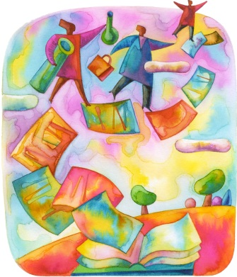
Components of the COFSP Fellows, RET/CEEMS Teachers and CEEMS Fellows Program 2015-2016 Program.
#2 Activity Development → Support from
CEEMS Fellows, RET Teachers
and RET Coordinator
RET Teacher and COFSP Fellow select a topic.
COFSP Fellow submits a draft to CEEMS Fellow.
COFSP Fellow gets feedback from RET Teacher and RET Coordinator.
COFSP Fellow finalizes Activity based on feedback.

Slide 14
Components of the COFSP Fellows, RET/CEEMS Teachers and CEEMS Fellows Program 2015-2016 Program.
#3 Activity Implementation → Support from
RET/CEEMS Teachers and RET Coordinator
COFSP Fellow teaches activity.
COFSP Fellow completes post teaching portions of Activity Template.
COFSP Fellow get feedback from RETS Teacher and RET Coordinator.
COFSP finalized Activity on template based on feedback.
COFSP Activities are published on the website.

Slide 15

Components of the COFSP Fellows, RET/CEEMS Teachers and CEEMS Fellows Program 2015-2016 Program.
#4 Bi- Weekly Seminars → Support from CEEMS Fellows, and RET Coordinator
COFSP Fellow keeps a journal.
COFSP Fellow conducts discussion based on readings.
COFSP Fellow completes other assignments designated by RET Coordinator.

Slide 16
Components of the COFSP Fellows, RET/CEEMS Teachers and CEEMS Fellows Program 2015-2016 Program.
#5 Deliverables → Support from CEEMS Fellows, RET/CEEMS Teachers and RET Coordinator
COFSP Fellow completes a reflective essay.
COFSP Fellow prepares a Power Point.
COFSP Fellow prepares a Poster.
COFSP Fellow presents at Final Presentation Event.

Slide 17
RET / Teachers and RET Coordinator
COFSP Fellows
CEEMS Fellows
KEY Players Provide:
      Preparation
      Support
      Planning
      Preparation
      Feedback
      Mentoring

Slide 18

Questions?
Components?
Key players?
Objectives or benefits?

Slide 19
Announcements Regarding PD Next Week - Monday, September 28th:
We are meeting in Swift 616.
Refreshments will be provided.
Meeting time again is 4:30 – 6:30.
The topic will be Engineering Design Process.

